Slide 1
Finance Dept Cost accounting, planning, budgeting & financial analysis
planning, budgeting, Communication (Integration) & control information System

Slide 2
Index
Introduction
Cost Accounting
ERP System Implementation
Training
Goals
Establishing Cost Accounting Division
Establishing Planning, Budgeting, Development & Growth Committee
Dedicated ERP System Project Management Skills (Key Users)
Information System Data Flow
Cost, Budgeting, ERP Accountant for each Project more than 50 Millions SAR
Cost, Budgeting & ERP Accounting Team for Each Project more than 100 Millions SAR
Cost, Budgeting, ERP Accountant for Each Factory
Stock, Purchase & Budget Accountant
Team Training
Requirements

Slide 3
INTRODUCTION

Slide 4
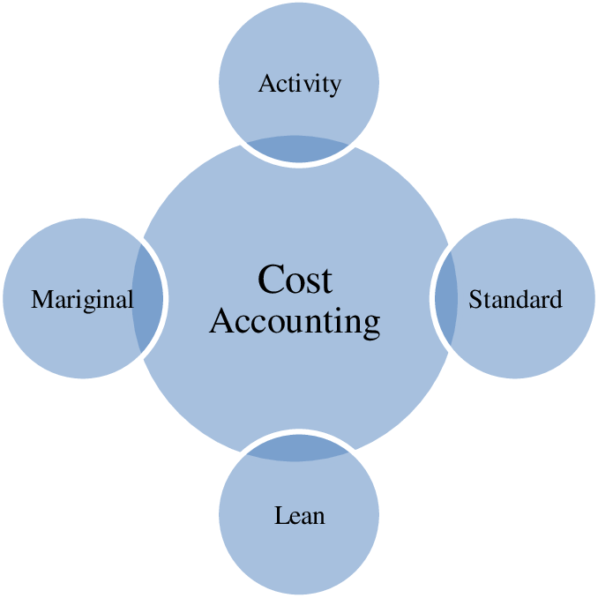
Cost accounting
Cost accounting is the reporting and analysis of a company's cost structure. Cost accounting involves assigning costs to cost objects that can include a company's products, services, and any business activities.

Slide 5
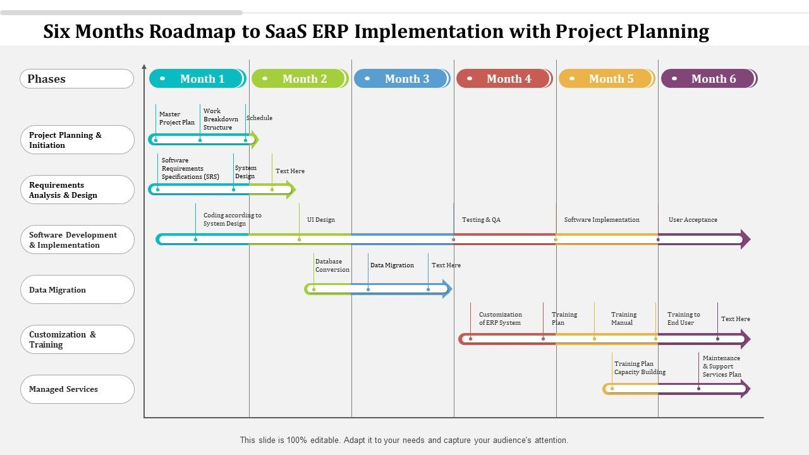
ERP System Implementation (Integration)

Slide 6
Goals

Slide 7
Establishing Cost Accounting Division
Tasks of the Cost Accounting (Project & Manufacturing):
Main Partner In The Planning and Development Committee & Its Tasks
Establishing & Training of Project Cost Accounting
Establishing & Training of Manufacturing Cost Accounting
Training of ERP System for General Accounting Dept.
Cost deviation reports
Budgeting
Direct salaries
Accounting integrations
Controlling costs
Financial analysis
Management assistance
Cost and revenues
Expenses
Expectation
Inventory Control

Slide 8
Establishing Planning, Budgeting, Development & Growth Committee
Tasks of the Planning and Development Committee:
Supervising the preparation and processing of the company’s strategic & implementation plan.
Follow up on the implementation, evaluation and update of the strategic plan.
Develop indicators to measure performance.
Follow up and evaluate the annual executive plans of departments and divisions periodically in light of the executive and strategic plan.
Review weekly/monthly/annual periodic reports and measure actual achievement rates.
Submitting reports to senior management with feedback on annual evaluations and measuring the level of progress achieved
Preparing development studies in light of periodic evaluation results

Slide 9
Establishing ERP System Project Management Skills (Key Users or Committee)
Tasks of the ERP System Project Management (Committee):
Identify and meet with the stakeholders
Build a comprehensive plan
Goals and objectives
Define the needed resources
Task assignment
Budget
Status updates
Risk management

Slide 10
Information System Data Flow
Finance
Planning and Development
Human Resource
Manufacturing
Logistic (Dispatch)
Information System
Stock Management
Maintenance
Procurement
Sales and Marketing
Quality Management

Slide 11
Requirements

Slide 12
Assign Cost Accounting Division
Projects (Contracts Cost Accounting) Including Planned Cost Budget, Cost Registrations & Analyzing
Tasks of the project cost accountant:
Monitoring the disbursement and cash flow of the project
Follow up on the project’s bank accounts
Monitoring the receipt and disbursement of project materials
Direct wage monitoring (attendance and salaries)
Monitoring other industrial costs (indirect) of the project
Follow up and inventory the work under implementation
Follow up on customer extracts (quantity and value)
Follow up on the project budget
Preparing and directing cost and revenue accounts for the project
Preparing periodic reports (weekly, monthly, etc.) for the project
Preparing performance reports and completion rates for the project

Slide 13
Assign Cost Accounting Division
Manufacturing (Industrial) Cost Accounting Including Planned Cost Budget, Cost Registrations & Analyzing
Tasks of the Factory cost accountant:
Monitoring the disbursement and cash custody of the factory
Follow up on the factory’s bank accounts
Monitoring the receipt and disbursement of factory materials
Direct monitoring of wages (attendance and salaries)
Monitoring other (indirect) industrial costs in the factory
Follow up on production under operation and final production
Follow up on customer extracts (quantity and value)
Follow up on the factory budget
Preparing and directing cost and revenue accounts for the factory
Preparing periodic reports (weekly, monthly, etc.) for the factory
Preparing performance reports and completion rates for the factory

Slide 14
Assign Planning and Development Committee
Planning and Development Committee Members:
Executive Management
Admin Management
Finance Dept.
Cost Accounting Dept.
Technical Office
Project Management
Manufacturing Management
ERP System Committee

Slide 15
Assign ERP System Project Management (Committee)
ERP System Project Management (Committee) Members:
Admin Management
Finance Dept.
HR Dept.
Technical Office
Project Management
Manufacturing Management
Stock, Purchase & Dispatch Management

Slide 16
The end thanks
Ahmed Ouf

